Slide 1
Transport Management System
CMIS 3122 –Rapid Application Development
Group No- 04
  Presenters………
  S.D.T.C.R.Wijerathne (152063)
  A.P.M.W.Arachchi (152004)

Slide 2
Introduction
Designed for “Chamod Transport Service”,a company that handles container transportation from harbor to islandwide locations.
Uses java as the programming language for front end development.
Uses MySQL for back end development.

Slide 3
Project Aims
Fully automated Order Handling
Providing financial status
Managing truck maintenance
Handling 3rd party requests
Automating driver salary calculations

Slide 4
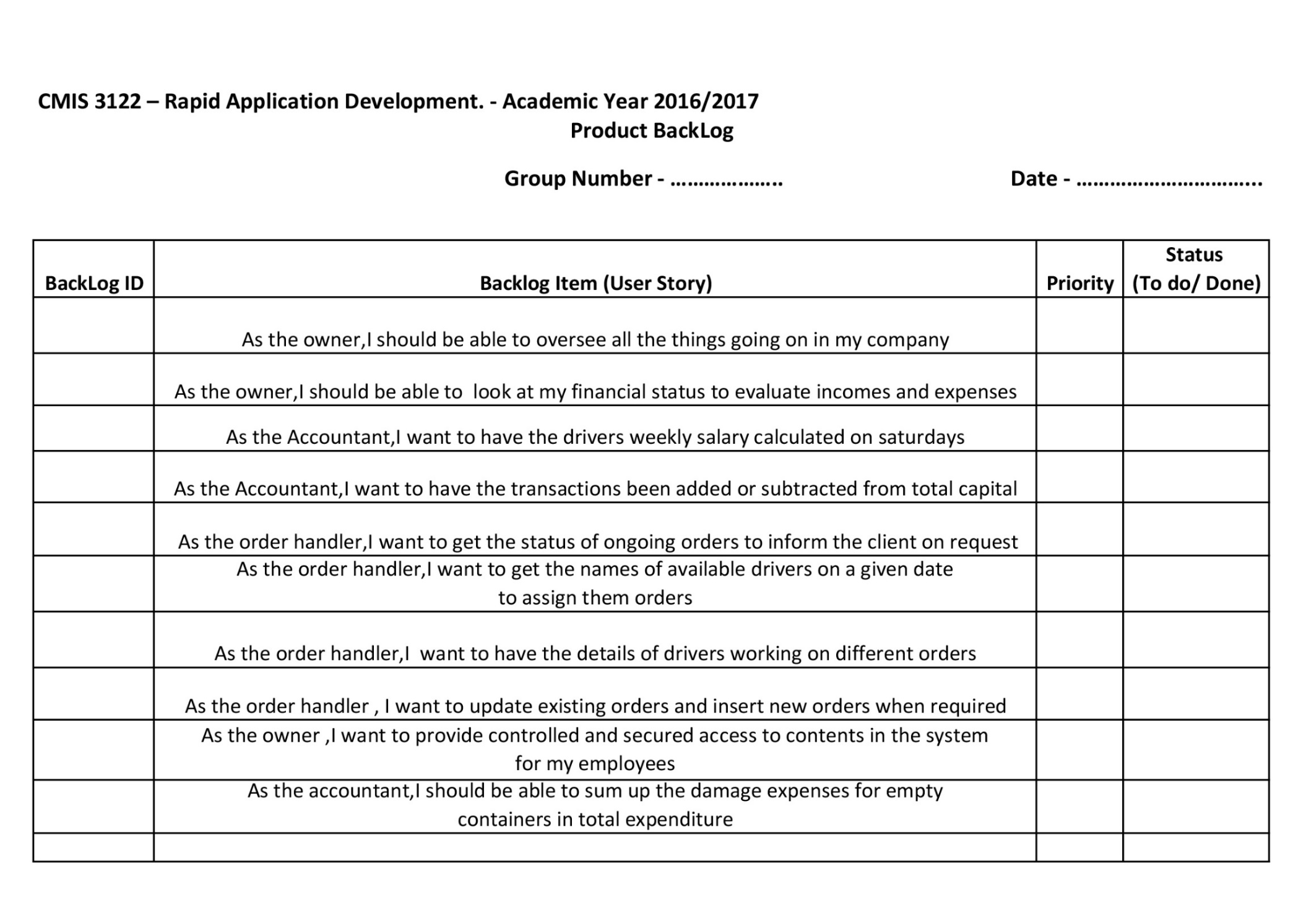

Slide 5
System Users
Manager
Order Handler
Cashier

Slide 6
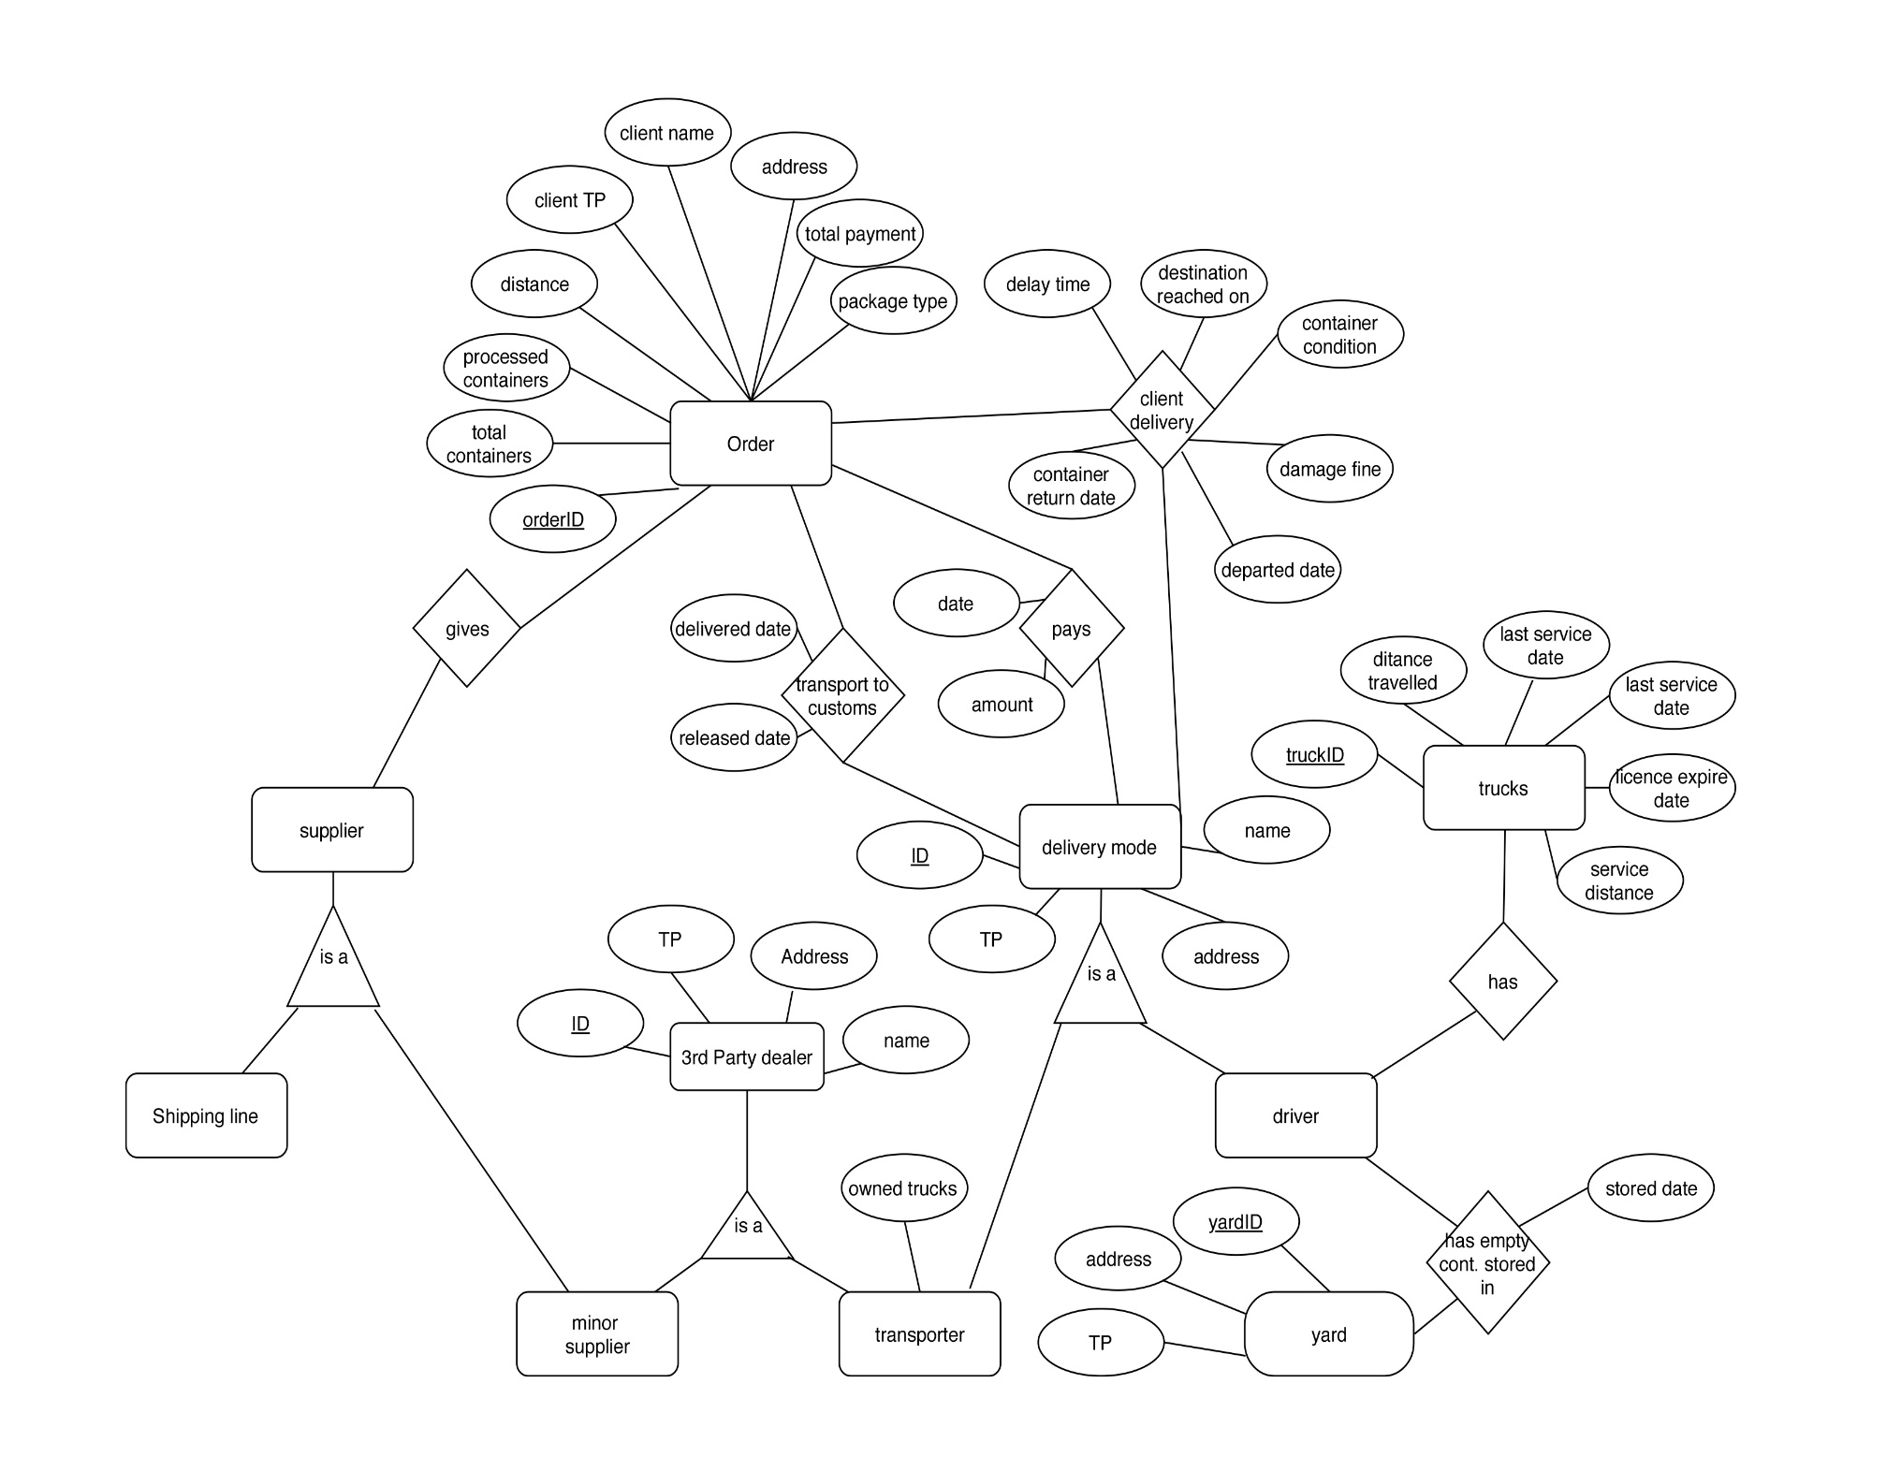

Slide 7
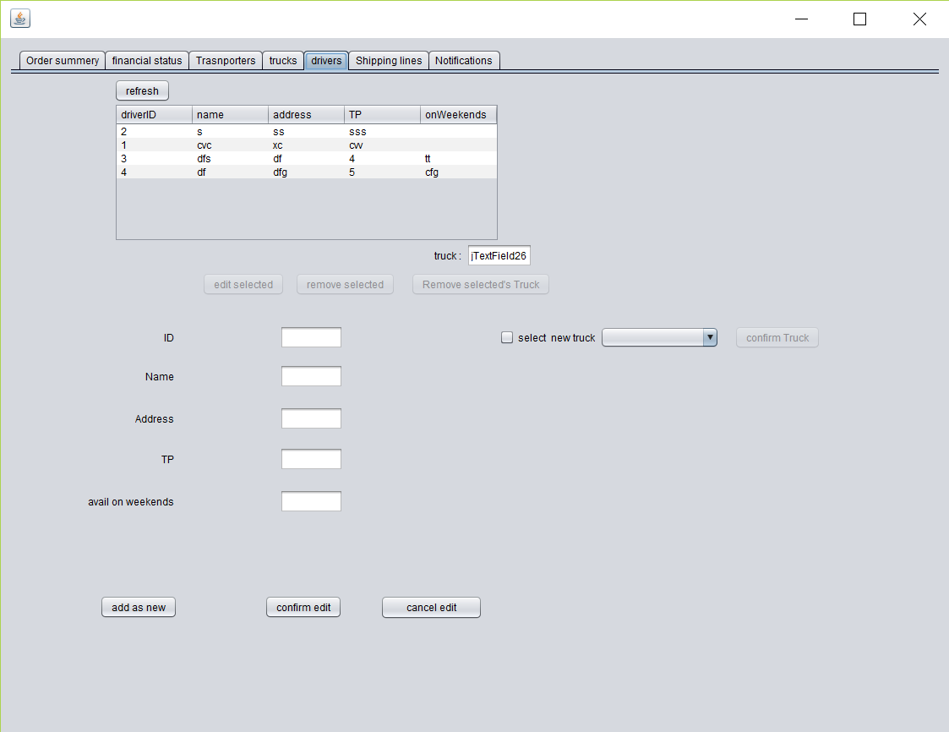
Manager Interface : Adding drivers/Assigning trucks

Slide 8
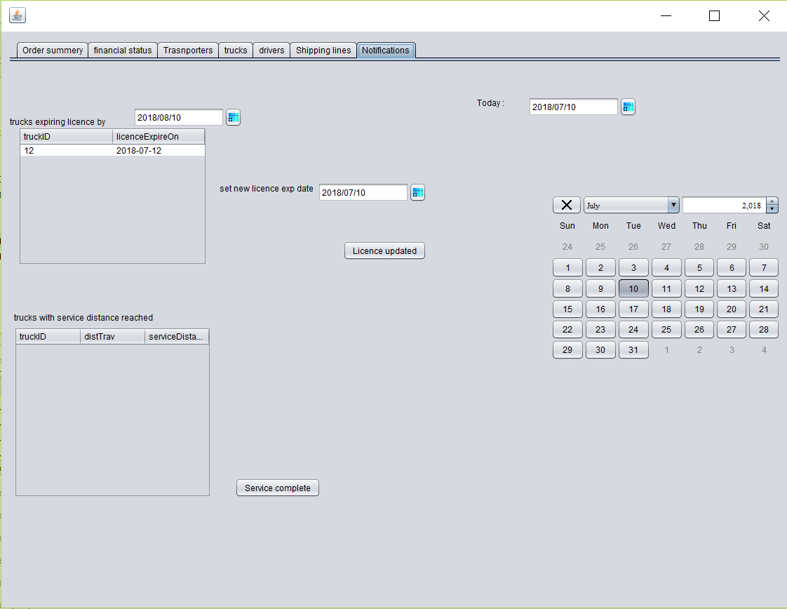
Manager Interface: Truck Maintenance

Slide 9
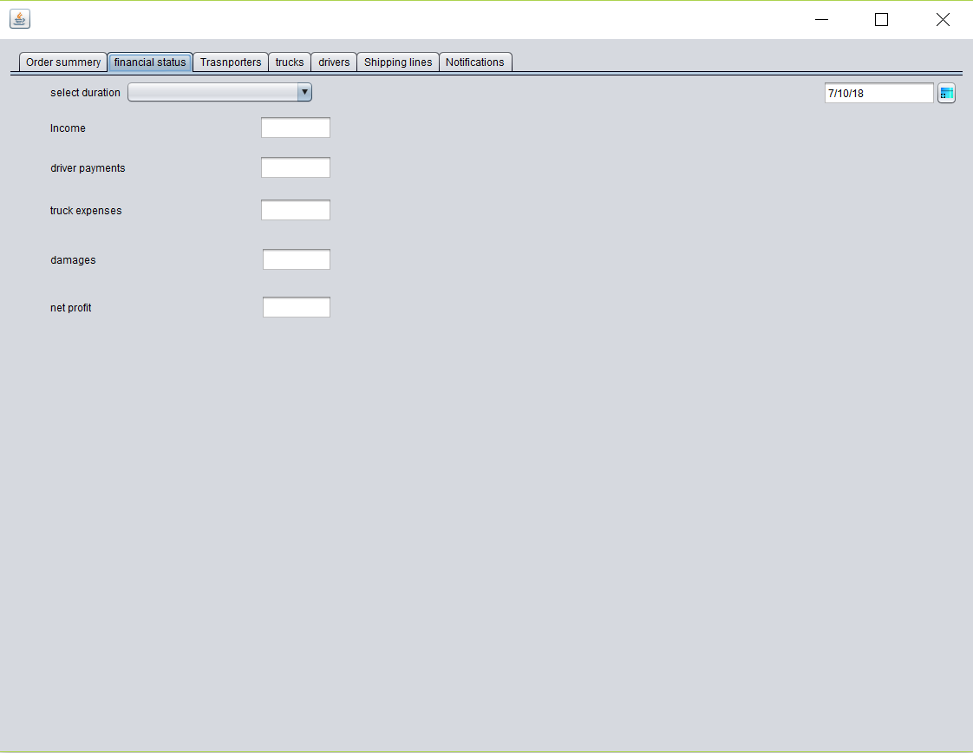
Manager Interface : Financial Status

Slide 10
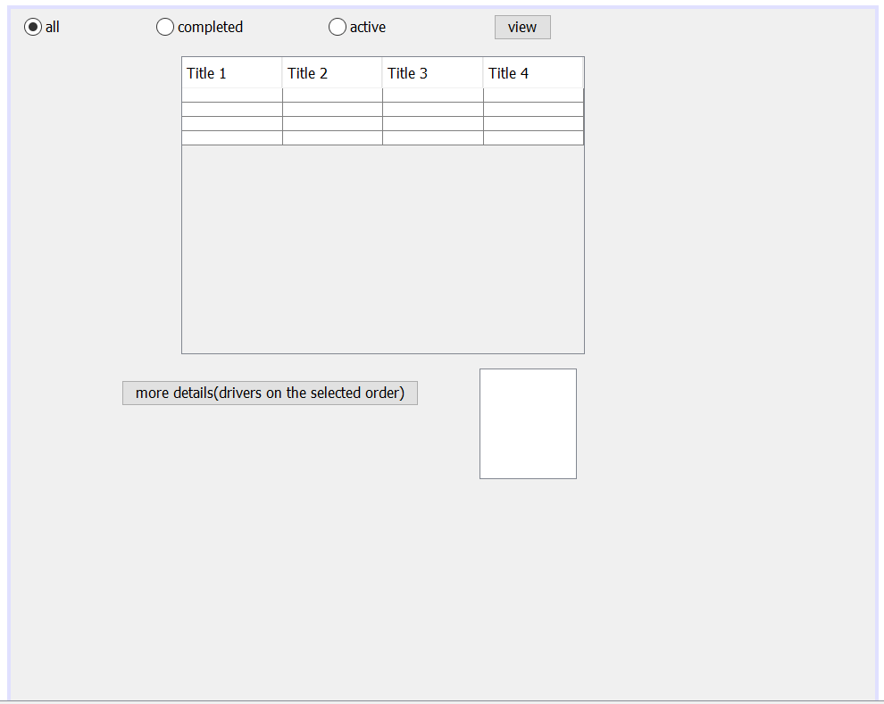
Viewing Orders

Slide 11
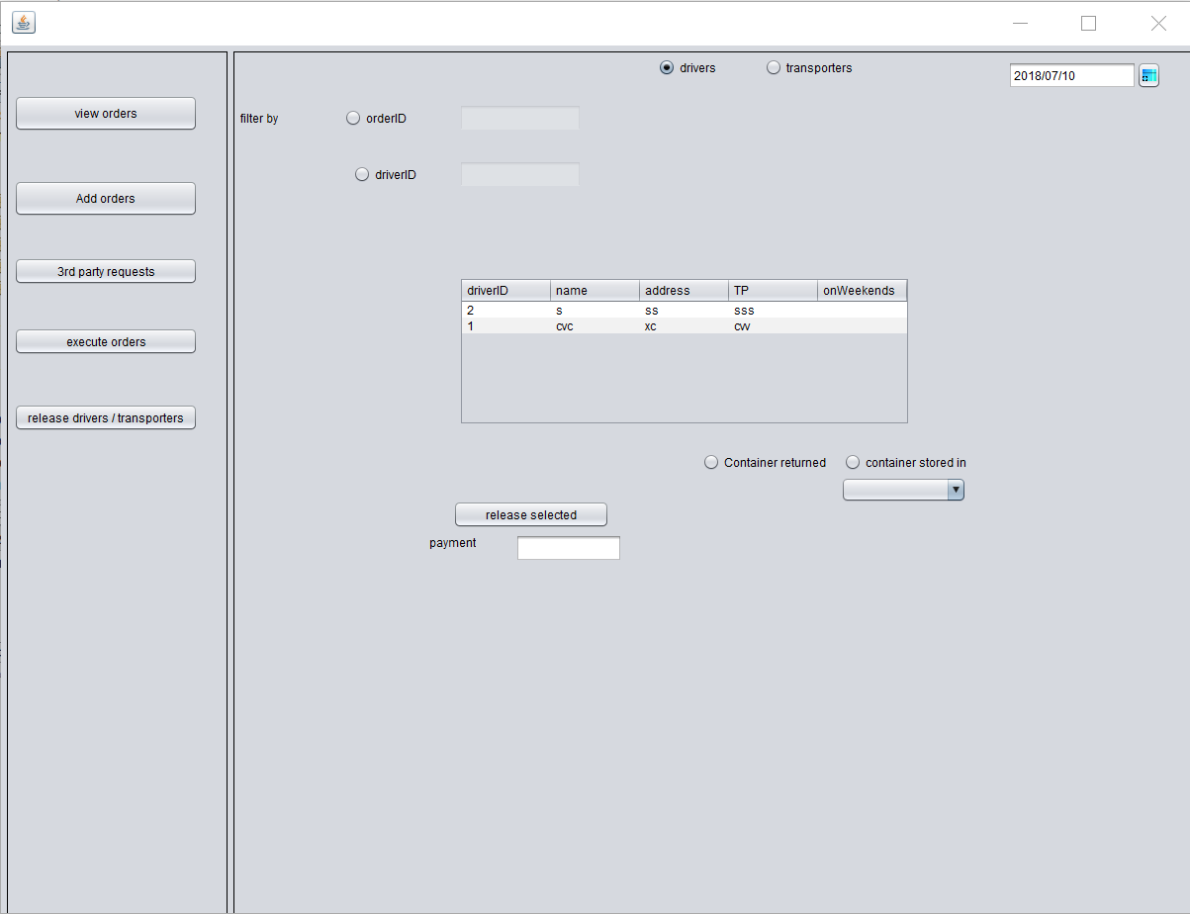
Order Handler :Releasing Drivers

Slide 12
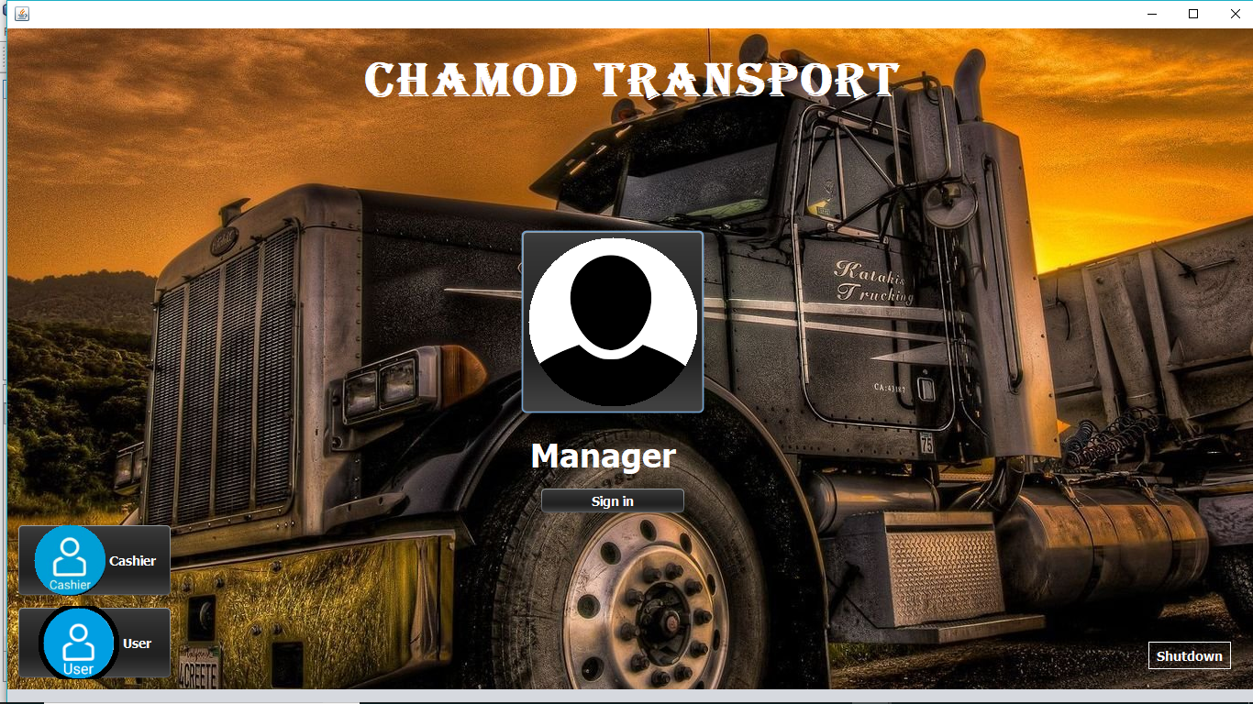
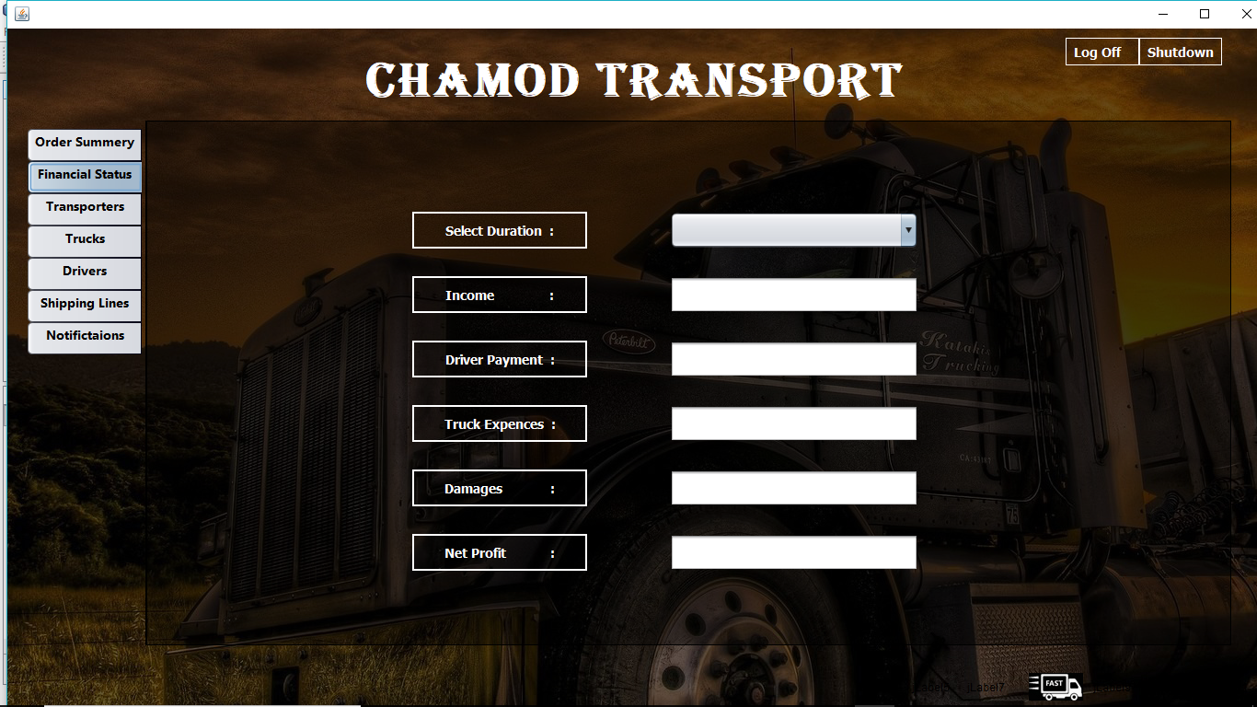
Planned Final GUI design

Slide 13
Work to be done
Calculating and Finalizing Driver’s Salary
View of Overall financial status
3rd party transaction handling
Processing Damage expenses
Input Validation

Slide 14
Completed Works
Insertion of :
-Drivers
-Trucks
-Transporters
-Shipping Lines
Assigning and removing of trucks from drivers
Adding a new order and executing all its stages
Viewing Orders ( with filtering)
Alerts on trucks requiring maintainance

Slide 15
Thank You

